Slide 1
(GAN)Text-To-Image with Generative Adversarial Networks
Under the guidance of Dr. Shilpa Sonawani
By
Faisal Irfan Shaikh roll no:58
Prn:1032231524 panel-E Btech Tycse

Slide 2
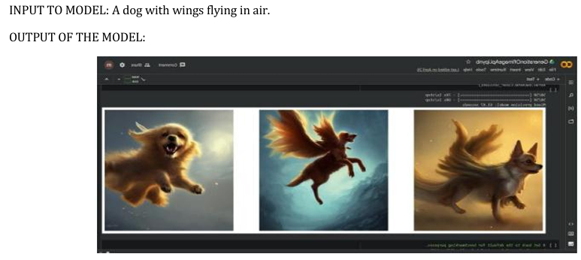
Index
• Introduction
• Background / Motivation
• Literature Review
• Research Gap
• Pros & Cons
• Applications
Future Scope
Key Features
• Conclusion
• References

Slide 3
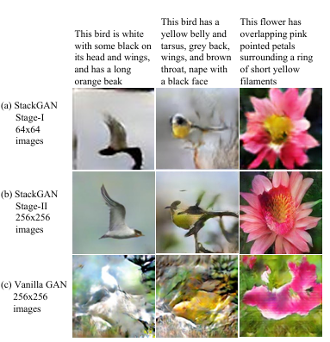
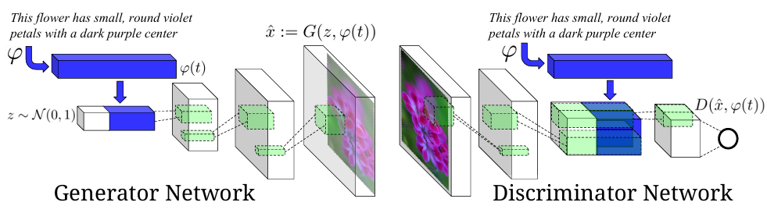
1. Introduction
Revolutionizing AI: GANs have transformed artificial intelligence by enabling high-quality image
synthesis from text.
Purpose of Text-to-Image GANs: Generate visually realistic images that align with given text prompts.
Learning Mechanism: Understands complex relationships between language and visual data.
Architecture:
Generator: Creates images from text embeddings.
Discriminator: Evaluates realism and relevance of generated images.

Slide 4
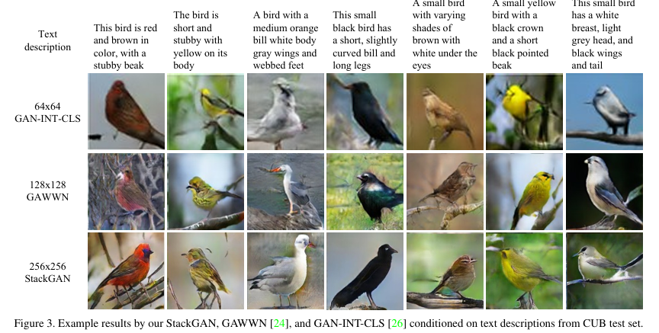
2. Background / Motivation
AI-driven Visualization: GANs help AI interpret and visualize human language.
Limitations of Traditional Methods: Requires manual effort and intervention.
GANs Automation: Learns from vast datasets to generate images.
Applications:
Creative Content (art, media).
Virtual Reality (realistic environments).
Medical Imaging (data visualization).
Interactive Storytelling (AI-generated narratives).
Challenges:
Mode Collapse (lack of diversity).
Training Instability (difficult optimization).
Text-Image Alignment Issues (accuracy concerns).

Slide 5
3.Literature Review
Significant advancements in text-to-image synthesis have been made through models like StackGAN, AttnGAN, and DALL·E.
StackGAN (2017) – Improves image resolution through a two-stage generation process.
AttnGAN (2018) – Uses attention mechanisms to enhance fine-grained text-image alignment.
DF-GAN (2020) – Introduces a single-stage generation process with improved efficiency.
DALL·E (2021) – Leverages transformer-based architectures to generate complex and diverse images from text.
Self-Conditioned GANs (2021) – Introduces controllability for generating more structured images from text prompts.

Slide 6
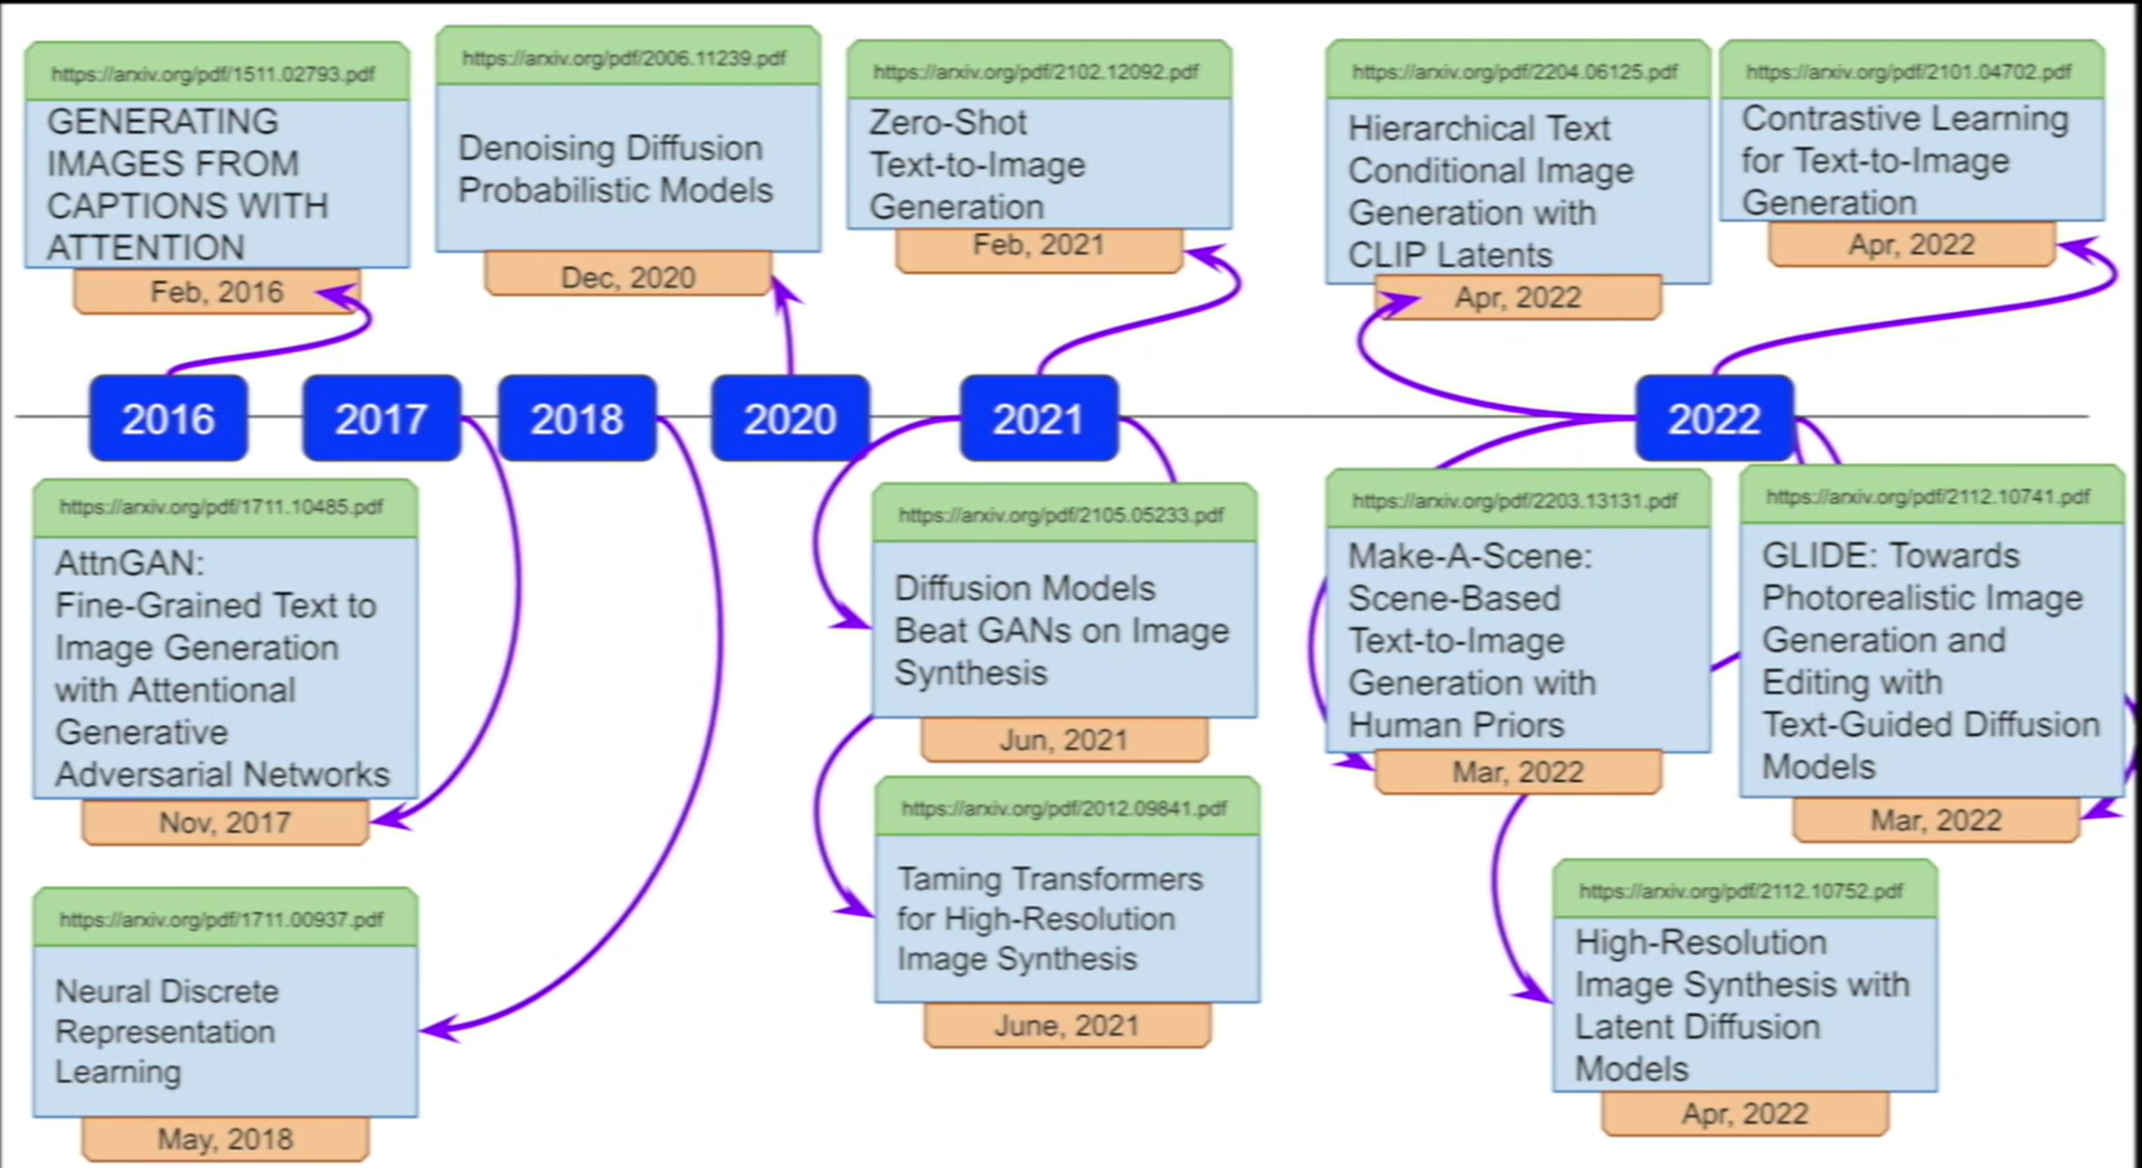

Slide 7
Literature Survey
Sr. No | Paper/Model Name | Year | Authors/Organization | Key Contributions | Limitations
1 | StackGAN | 2017 | Han Zhang et al. | Two-stage GAN that generates high-resolution images from text descriptions. | Struggles with complex scenes and fine-grained details.
2 | AttnGAN | 2018 | Tao Xu et al. | Introduced attention mechanism for better alignment between text and image. | Requires large training data; training is computationally expensive.
3 | DM-GAN | 2019 | Minfeng Zhu et al. | Dynamically refines generated images with memory networks. | Difficult to train and fine-tune.
4 | DALL·E | 2021 | OpenAI | Uses transformer architecture to generate diverse and creative images from text. | Not open-source initially; requires significant computational resources.
5 | GLIDE | 2022 | OpenAI | Diffusion-based text-to-image generation with classifier-free guidance. | Limited public availability; requires GPU power.
6 | Stable Diffusion | 2022 | CompVis & Stability AI | Latent Diffusion Model with CLIP text embeddings for high-quality outputs. | May sometimes generate irrelevant images for ambiguous prompts.
7 | Imagen | 2022 | Google Brain | Achieves SOTA with large language model conditioning and super-resolution stages. | Proprietary and not open to the public.

Slide 8
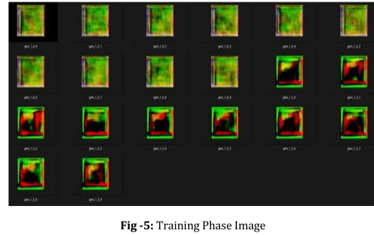
4. Research Gap
Despite progress, current Text-to-Image GANs face several challenges:
Text-Image Consistency – Ensuring accurate alignment between text and generated images.
High Computational Costs – Requires powerful GPUs and large datasets.
Limited Output Diversity – Some models generate repetitive images for similar prompts.
Bias in Data – Models may reflect biases present in training datasets.
Mode Collapse – Generates limited variations instead of diverse results

Slide 9
5. Pros & Cons
Advantages:
AI-driven creative content generation.
Automates and speeds up the design process.
Enhances virtual & augmented reality experiences.
Medical imaging – Generates missing or enhanced visuals.
Disadvantages:
High computational costs – Requires powerful GPUs.
Bias issues – Inherited from training datasets.
Text-image consistency challenges – Difficult to maintain accuracy.
Risk of misuse – Potential for generating fake or misleading images.

Slide 10
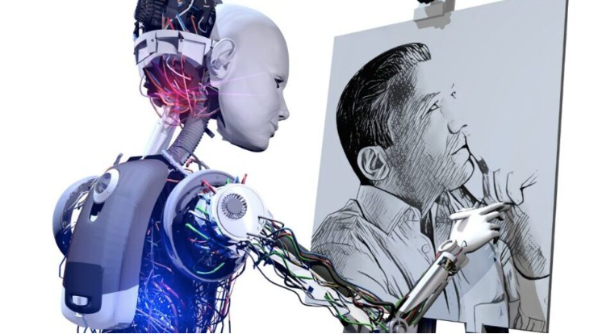
6. Applications
Graphic Design & Art Creation – Generate illustrations, concept art, and digital paintings.
Advertising & Marketing – Create custom visuals for campaigns instantly.
Gaming & Animation – Design characters, backgrounds, and game assets.
Fashion & Interior Design – Visualize outfits, room layouts, and decor ideas.
Education & E-learning – Produce engaging visual content for learning materials.
Entertainment & Storyboarding – Develop scenes for films, comics, and storybooks.
Virtual Worlds & Metaverse – Generate 3D assets and environments.
Personal Avatars & Memes – Create personalized profile pictures, memes, or AI art.
Medical & Scientific Visualization – Simulate visuals based on research descriptions.
Accessibility Tools – Assist visually impaired users by generating images from text.

Slide 11
Future Scope
Text-to-Image Generation using Stable Diffusion and Diffusers
Integration with large language models for better prompt understanding.
Support for high-resolution (4K/8K) image generation.
Real-time generation through model optimization.
Personalized outputs using LoRA or DreamBooth fine-tuning.
Multimodal integration (text, audio, video).
Built-in safety features and ethical content generation.
Plugins for game and design engines (e.g., Unity, Blender).
Interactive and editable generative interfaces.

Slide 12
Key Features
Feature | Description
StableDiffusionPipeline | Generate images from text
StableDiffusionImg2ImgPipeline | Transform images based on text
StableDiffusionInpaintPipeline | Fill missing areas in an image
ControlNet | Add structured control like depth maps, edge maps
DiffusionPipeline | Base class for all diffusion models
Scheduler classes | Handle the denoising process (e.g., DDIM, DDPMScheduler, etc.)
Integration with transformers | For text encoders like CLIP or BERT

Slide 13
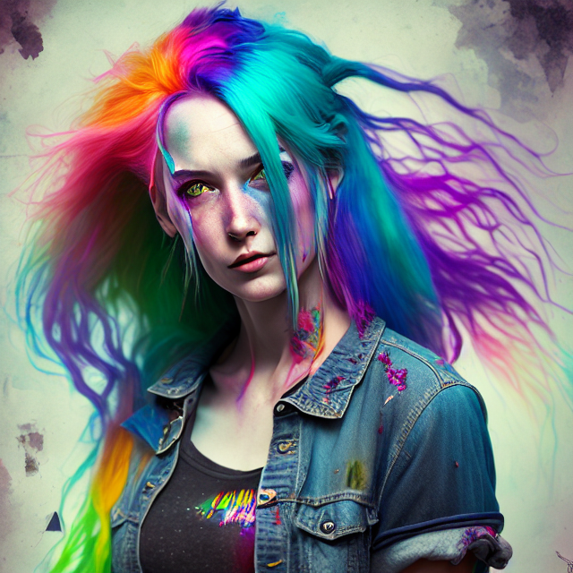
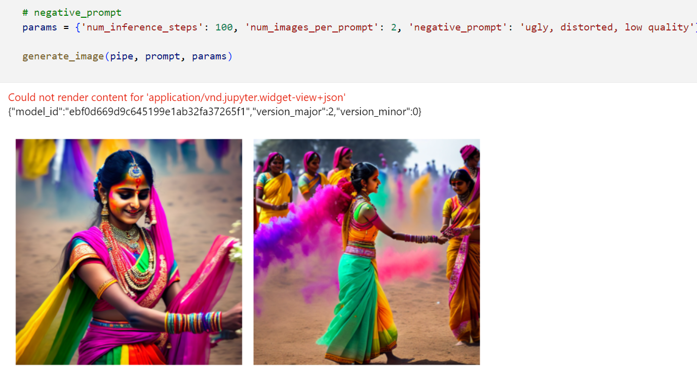
Output:
prompt = """dreamlikeart, a grungy woman with rainbow hair, travelling between dimensions, dynamic pose, happy, soft eyes and narrow chin,extreme bokeh, dainty figure, long hair straight down, torn kawaii shirt and baggy jeans"""

Slide 14
7.Conclusion
Text-to-Image GANs represent a major advancement in AI-driven content creation. Despite their current limitations, ongoing research into improved architectures, transformer-GAN hybrids, and ethical considerations will enhance their capabilities. The future of AI-powered image generation promises advancements in digital art, automated storytelling, and human-computer interaction.
Future Promise: Advancements in digital art, automated storytelling, and human-computer interaction
Text-to-Image GANs: Major advancement in AI-driven content creation
Current Limitations: Challenges in image quality and coherence
Ongoing Research: Focus on improved architectures and transformer-GAN hybrids
Ethical Considerations: Addressing concerns around content creation and misuse

Slide 15
8. References
I. Goodfellow et al., "Generative Adversarial Networks," Advances in Neural Information Processing Systems (NeurIPS), 2014.
H. Zhang et al., "StackGAN: Text to Photo-realistic Image Synthesis with Stacked Generative Adversarial Networks," IEEE Transactions on Pattern Analysis and Machine Intelligence, vol. 41, no. 8, pp. 1947-1962, 2019.
P. Isola et al., "Image-to-Image Translation with Conditional Adversarial Networks," IEEE Conference on Computer Vision and Pattern Recognition (CVPR), 2017.
A. Radford et al., "Unsupervised Representation Learning with Deep Convolutional Generative Adversarial Networks," International Conference on Learning Representations (ICLR), 2016.
A. Ramesh et al., "Zero-Shot Text-to-Image Generation," Advances in Neural Information Processing Systems (NeurIPS), 2021.
T. Xu et al., "AttnGAN: Fine-Grained Text to Image Generation with Attentional Generative Adversarial Networks," IEEE Conference on Computer Vision and Pattern Recognition (CVPR), 2018.
J. Choi et al., "Text-to-Image Generation Using GANs: A Review," IEEE Access, vol. 9, pp. 162875-162894, 2021.
X. Wang et al., "Towards More Controllable Text-to-Image Generation with Self-Conditioned GANs," IEEE/CVF International Conference on Computer Vision (ICCV), 2021.
R. Zhang et al., "Large-Scale Text-to-Image Generation with Flexible Object Layouts," IEEE Transactions on Pattern Analysis and Machine Intelligence, vol. 45, no. 3, pp. 1-14, 2023.

Slide 16


